Slide 1
SpeechTokenizer: Codec Based ASR
Group 41
Aryan Bhosale, 210040024
Atishay Jain, 210050026
Faizan Ansari, 210100058
Areeb Asgar , 210100022
Date: 29/11/24

Slide 2

Problem Statement
Input: Audio speech (*.flac)
Output: Transcribed text
Example:
Input:
Output: REST AND BE STILL UNTIL I WARN YOU

Slide 3
Motivation
SpeechTokenizer introduces unified speech tokens which combine semantic and acoustic info to create better speech representations
It outperforms existing models like
EnCodec on speech reconstruction
VALL-E in zero-shot TTS
Our hypothesis is that it would perform better on ASR tasks as well

Slide 4
Dataset
Data instance
ID,duration,wav,spk_id,wrd
61-70970-0017,2.55,LibriSpeech/test-clean/61/70970/61-70970-0017.flac,61-70970,REST AND BE STILL UNTIL I WARN YOU
Total Duration: Approximately 100.6 hours of audio.
Sampling Rate: 16 kHz.
Speaker Distribution:
Total Speakers: 251 (Female Speakers: 125, Male Speakers: 126)
Data Split:
Training Set:
train-clean-100: 100.6 hours - "clean" indicates that the recordings are of higher quality, featuring speakers with clearer pronunciation and less background noise. This set is ideal for training ASR models as it includes data from speakers who are generally easier to understand.
Validation Set:
dev-clean: 5.4 hours
dev-other: 5.3 hours - "other," meaning they may contain more challenging speech characteristics such as varied accents or background noise.
Test Set:
test-clean: 5.4 hours
test-other: 5.1 hours

Slide 5
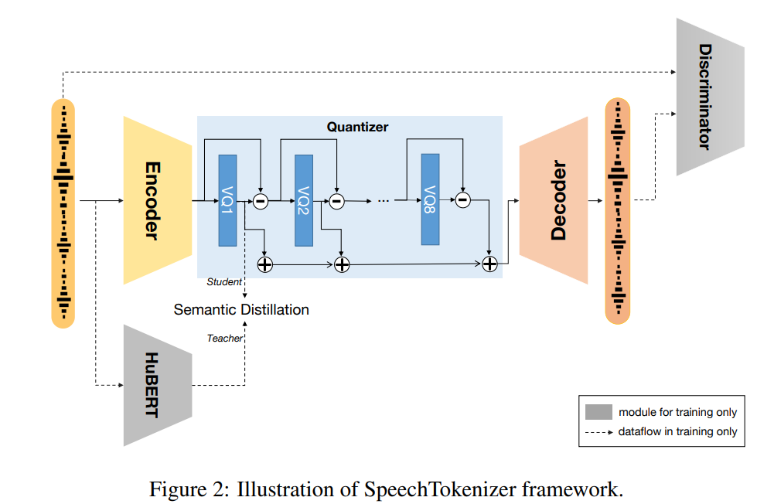
Literature Review
Why SpeechTokenizer?
The unified speech tokens proposed here outperform existing models in speech reconstruction and Text-to-Speech (TTS) tasks
Using semantic distillation it is able to extract semantic and acoustic content from speech. We believe this can help in achieving great results in automatic speech recognition tasks as well
We intend to use these speech tokens as input for an ASR pipeline using ASR recipe from Speechbrain library.

Slide 6
Method/Technique
We have implemented the code in Speechbrain.
Experiments:
Codec used: SpeechTokenizer
ASR Architecture used: Bi-LSTM, Contextnet
Codec used: Descript Audio Codec (SOTA, baseline)
ASR Architecture used: Bi-LSTM, Contextnet

Slide 7
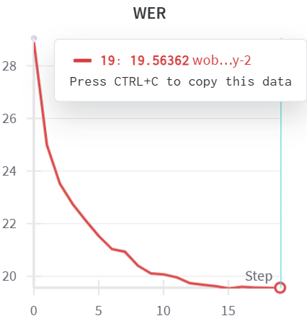
Results
Our model outperforms DAC by 41.21% on test-clean and 39.01% on test-other on the LibriSpeech-100h
Codec | ASR Model | WER test-clean | WER test-other
DAC | LSTM | 60.86 | 81.94
 | Contextnet | 117.91 | 115.04
Codec | ASR Model | WER test-clean | WER test-other
Speech Tokenizer | LSTM | 19.65 | 42.93
 | Contextnet | 27.39 | 48.32
Training Logs

Slide 8
Analysis
Our model outperforms DAC by 41.21% on test-clean and 39.01% on test-other on the LibriSpeech-100h
Bi-LSTM pipeline outperforms Contextnet pipelined for both codecs
SpeechTokenizer, even when used with Contextnet outperforms DAC by a large margin ( 33.47% test-clean, 33.62 test-clean)

Slide 9
Error analysis
Common Errors
Substitutions (majority of errors): words were often misrecognized, leading to majority of WER
Insertions: words added erroneously
Deletions: words omitted erroneously
High WER
“A STORY” -> “A STURRY” (substitution)
“VERSE TWO” -> “FIRST TOO” (2 substitutions)
4970-29093-0017, %WER 44.44 [ 4 / 9, 1 ins, 0 del, 3 sub ]
I'VE ; BEEN ; READY ; TO ; GO ; ANYWHERE ; <eps> ; FOR ; SIX ; MONTHS
A'B ; BEN ; READY ; TO ; GO ; EN ; HEWHERE ; FOR ; SIX ; MONTHS
Low or zero WER
4970-29095-0000, %WER 0.00 [ 0 / 6, 0 ins, 0 del, 0 sub ]
SHE ; WAS ; TIRED ; OF ; OTHER ; THINGS
SHE ; WAS ; TIRED ; OF ; OTHER ; THINGS

Slide 10
Error analysis
Focus on Substitutions
Refining the language model or phonetic matching algorithms could address the high substitution rate
Contextual understanding might help with cases like STURRY and STORY
We also tested by our own audios in different accents
Original Sentence
PLEASE PASS ME THE WATER
British Accent -> more WER
“PLEASE PASSD ME THE WOL TELT”
American Accent -> WER less
“PLEASE PASS ME THE WATER”
Indian Accent -> more WER
“MLEAST LOSED ME THE WARERS”

Slide 11
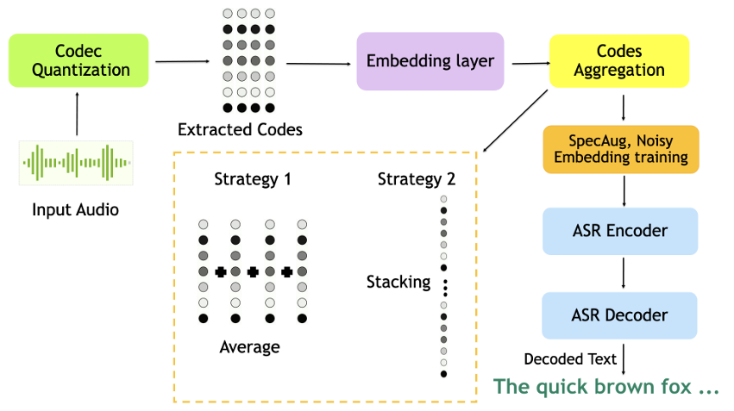
Improvements over the paper
Paper was only about speech reconstruction and TTS. We have used the SpeechTokenizer representations as input for an ASR pipeline.
Compared this to other codec based architectures such as DescriptAudioCodec (state of the art)
Also, implemented ASR using DAC codes as input

Slide 12
Learnings
Gained insights on speech tokenization for enhanced semantic and acoustic feature representation.
End to end ASR pipeline implementation using speechbrain.
Innovated SpeechTokenizer applications and extended its use case to ASR.

Slide 13
Evaluation Scheme
Demo working- ((10) if not working or no GUI - (0))​
Literature understanding- (10)
Analysis- (10)
Improvement over paper- (10)
Note: Must have GUI, otherwise no mark will be given for demo.​

